Slide 1

Ready for presentation?
Subject
The Mimops
Password
Log In

Slide 2





Home
The Title
Home
Subject
Code
Topics
List of Members
Content
@lee_seunghoon @Seungy8nie
@heyOhnim @jinuwu

Slide 3
Home
The Subtopic
Home
Start
Subject
This presentation is about presentation is about presentation is about presentation is about presentation is about presentation that include the presentation is about the presentation.
This is point number one
This is point number two
This is point number three
This is no point at all.
Code
Topics
Content

Slide 4
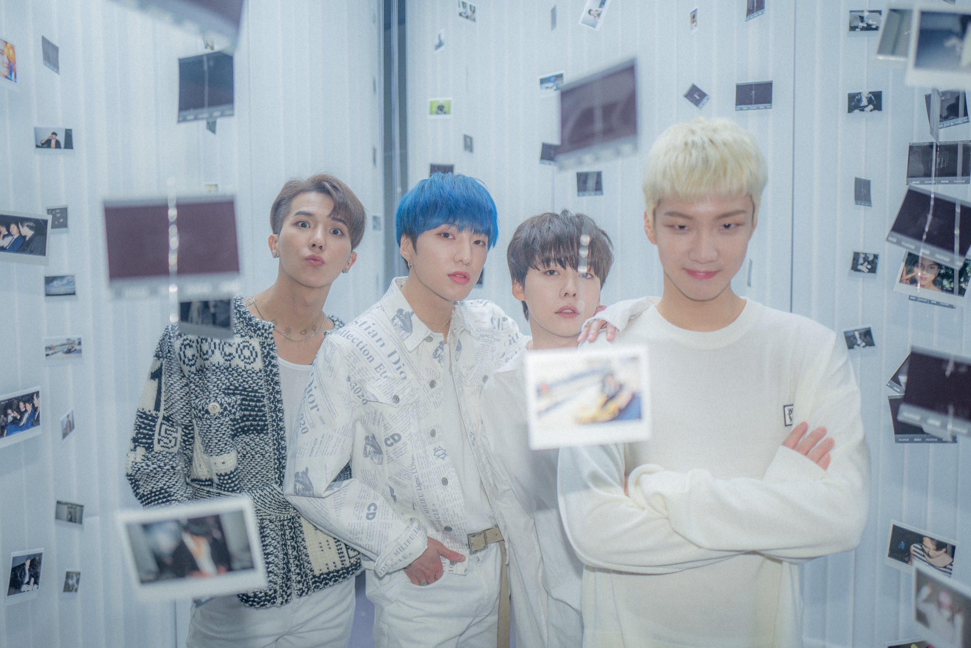
This is the place for this picture description. Put your picture under this. The picture under this is four precious human being. Stan winner for better hearing.
Home
#twitter #winner
Subject
Code
Topics
Content

Slide 5
This presentation is about presentation is about presentation is about presentation is about presentation is about presentation that include the presentation is about the presentation.
Home
#twitter #winner
Subject
This presentation is about presentation is about presentation is about presentation.
This is point number one
This is point number two
This is point number three
This is no point at all.
Code
Topics
Content
This presentation is about presentation is about presentation is about presentation is about presentation is about presentation that include the presentation is about the presentation.

